Slide 1
Types of Inheritance

Slide 2
Single Inheritance
Single inheritance refers to a scenario where a class inherits from only one superclass. It's a simple form of inheritance, where a derived class (subclass) inherits the properties and behaviors of a single base class (superclass).

Slide 3
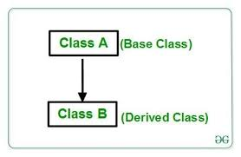

Slide 4
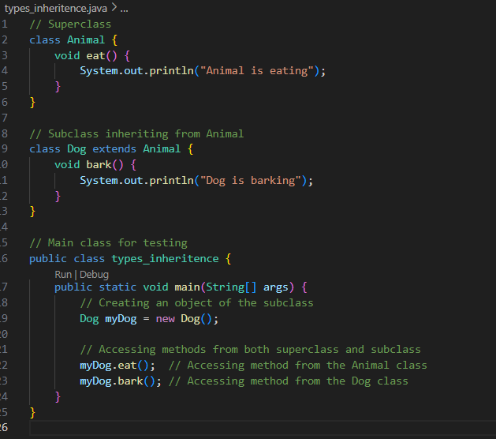
In Java

Slide 5
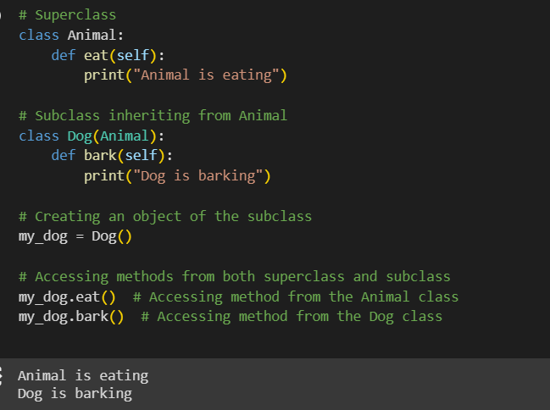
In Python

Slide 6
Multiple Inheritance
Multiple inheritance refers to a situation in object-oriented programming where a class can inherit attributes and methods from more than one parent class. In other words, a class can be derived from more than one base classes, and it inherits features from all of them.
Note: Java Does not support Multiple Inheritance. Why?

Slide 7
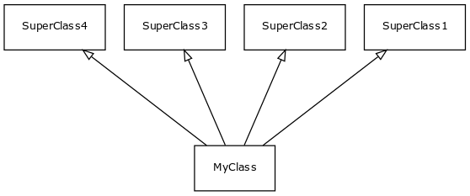

Slide 8
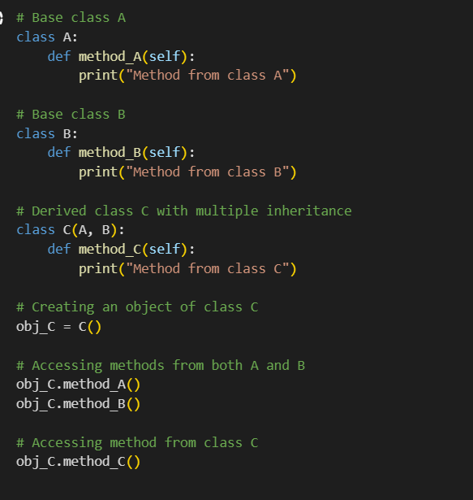
In Python

Slide 9
Multilevel Inheritance
Multilevel inheritance is a type of inheritance in which a derived class inherits from a base class, and then another class inherits from this derived class, forming a chain of inheritance.

Slide 10
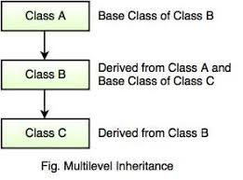

Slide 11
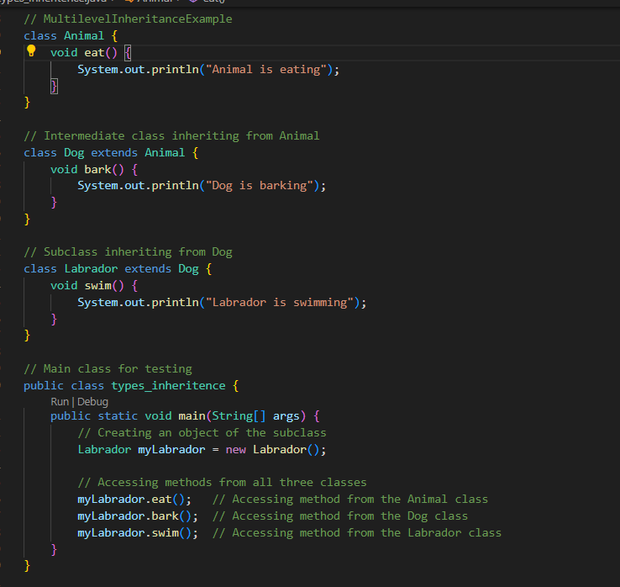
In Java

Slide 12
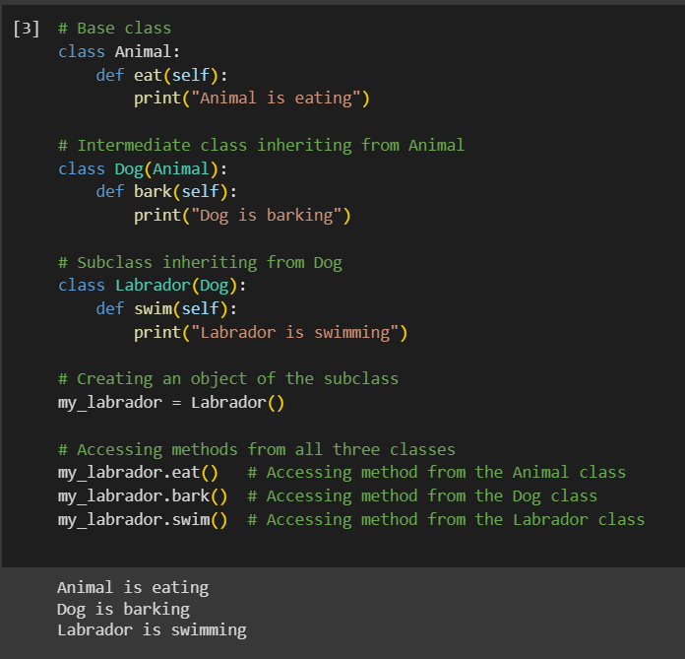
In Python

Slide 13
Hierarchical Inheritance
Hierarchical inheritance is a type of inheritance in which a single base class is inherited by multiple derived classes. Each derived class becomes a base class for other classes.

Slide 14
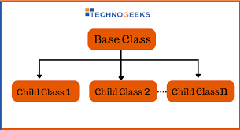

Slide 15
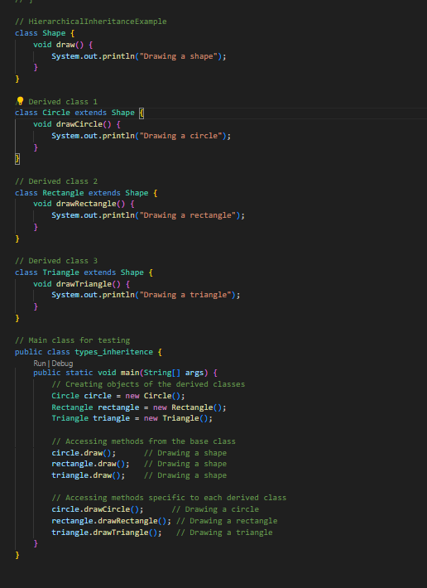
In Java

Slide 16
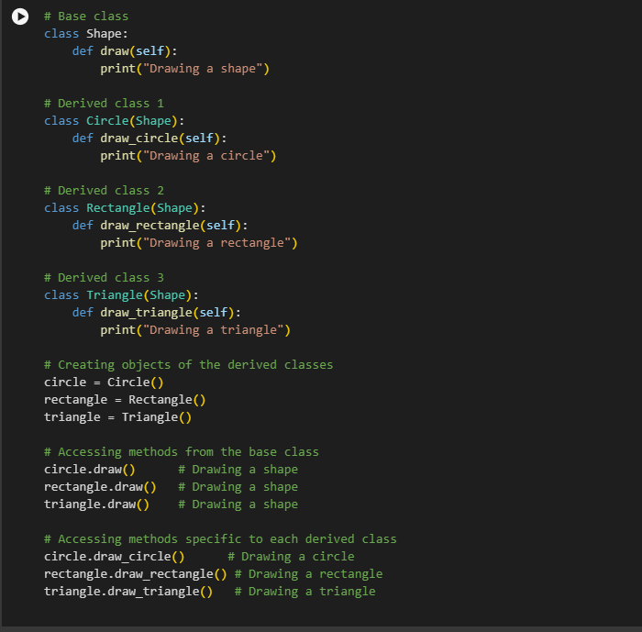
In Python

Slide 17
Task…….!
Hierarchical Inheritance:
Task: Shape Hierarchy
Create a base class Shape with a method draw().
Implement two derived classes, Circle and Rectangle, inheriting from Shape.
Create objects of both derived classes and invoke the draw() method.
Task: Employee Hierarchy
Create a base class Employee with attributes name and salary.
Implement two derived classes, Manager and Developer, inheriting from Employee.
Include specific attributes for each derived class.
Create objects of both derived classes and display their information.

Slide 18
Single Inheritance:
Task: Animal Hierarchy
Create a base class Animal with a method makeSound().
Implement a derived class Dog that inherits from Animal.
Add a specific method bark() to the Dog class.
Create an object of the Dog class and call both makeSound() and bark().
Hierarchical and Multilevel Inheritance:
Task: School Hierarchy
Create a base class Person with attributes name and age.
Implement two derived classes, Student and Teacher, inheriting from Person.
Further, implement a class TeachingAssistant that inherits from Teacher.
Create objects of each class and display relevant information.
Multilevel Inheritance:
Task: Vehicle Hierarchy
Create a base class Vehicle with attributes brand and year.
Implement a derived class Car that inherits from Vehicle.
Further implement a class SportsCar that inherits from Car.
Create an object of the SportsCar class and display its brand, year, and any additional attributes.

